Slide 1
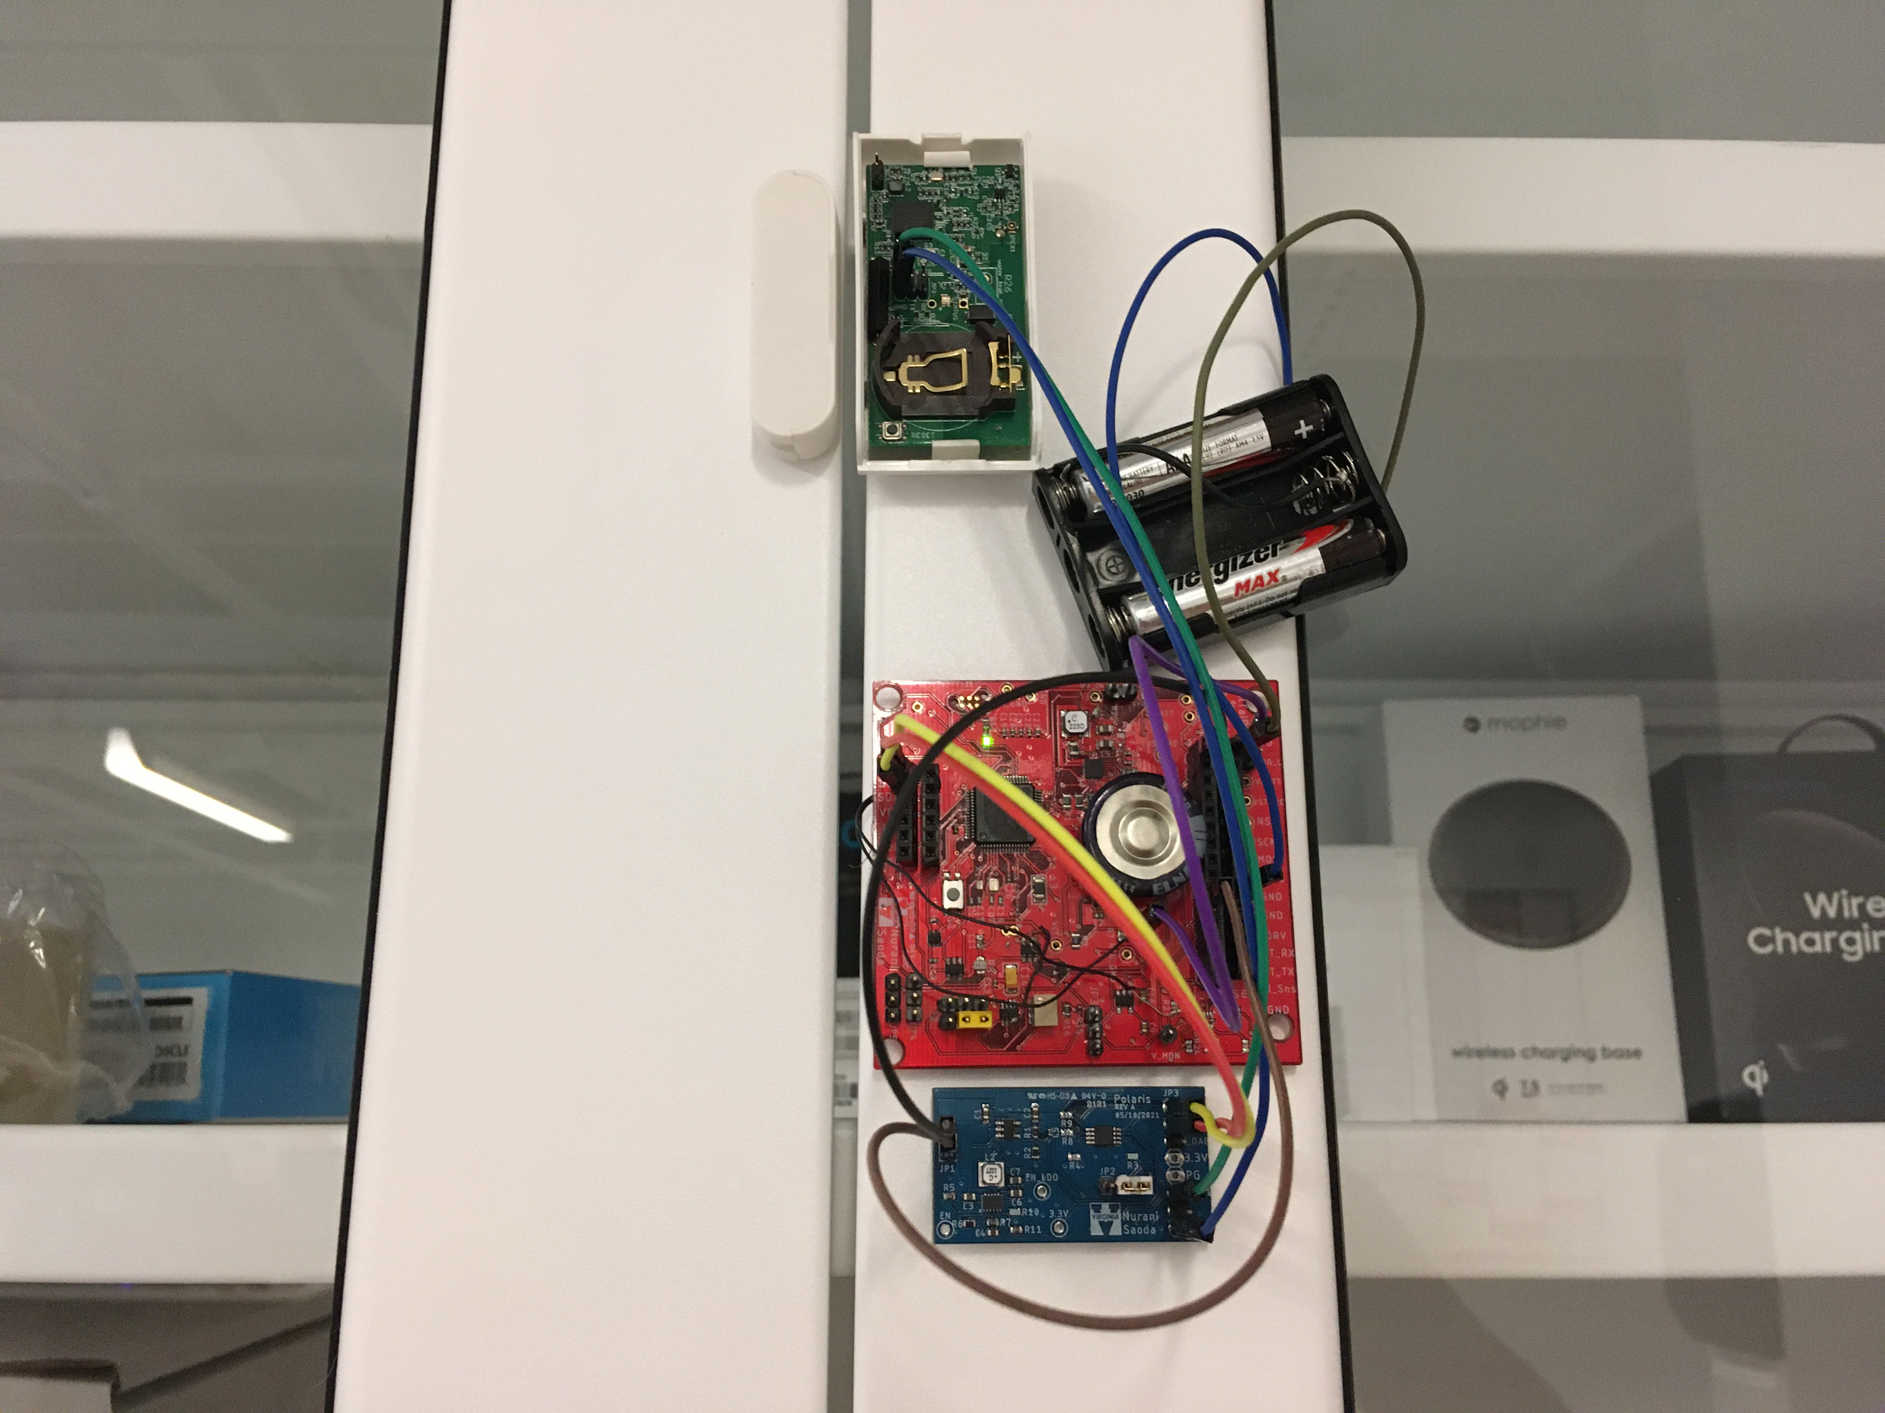

RetroIoT: Retrofitting Internet of Things Deployments by Hiding Data in Battery Readings
Nurani Saoda*, Victor Ariel Leal Sobral*, Ruchir Shah, Wenpeng Wang, Bradford Campbell University of Virginia
ACM MobiCom’22, Oct 17-21, 2022 Sydney, Australia
Link Lab

Slide 2


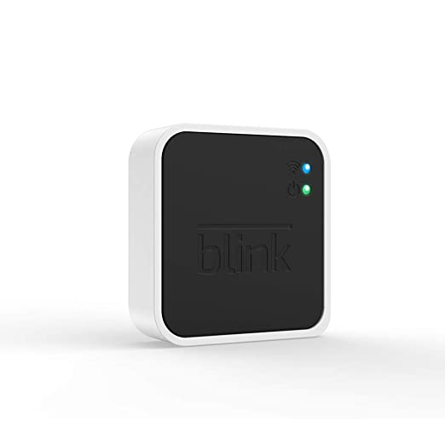
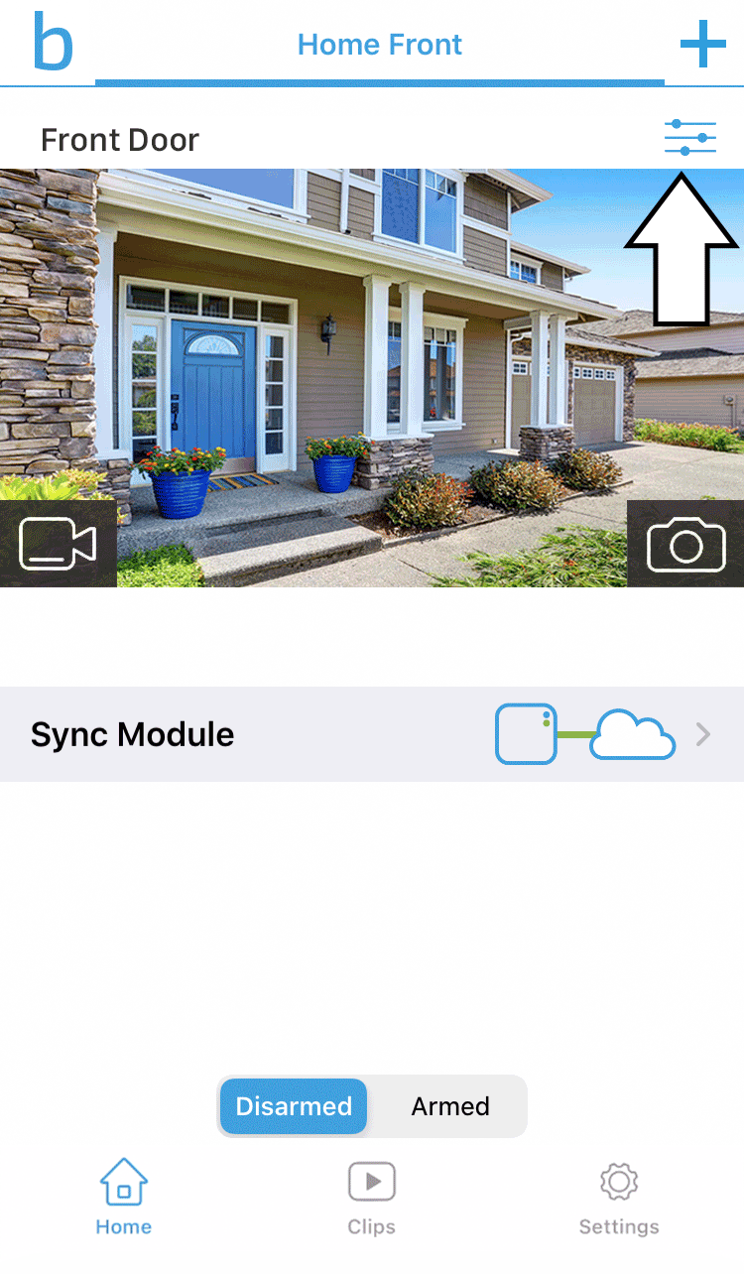
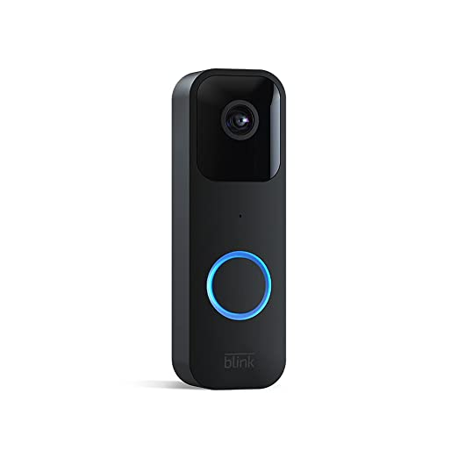
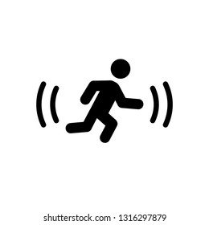


Commercial IoT systems are not upgrade-friendly
Link Lab
Let’s look at an example ..
Press/motion activated blink video doorbell
End users can not add their own device
Upgrading or adding new functionality requires replacing all devices
Technology advances keep making devices obsolete
Blink Gateway
Amazon cloud
What if the user wants a new trigger feature for the doorbell?
Notes:
Example: a door bell with a press switch upgrades to door bell if motion is detected
With closed source implementation we are simply limiting the potentials of existing facilities

Slide 3


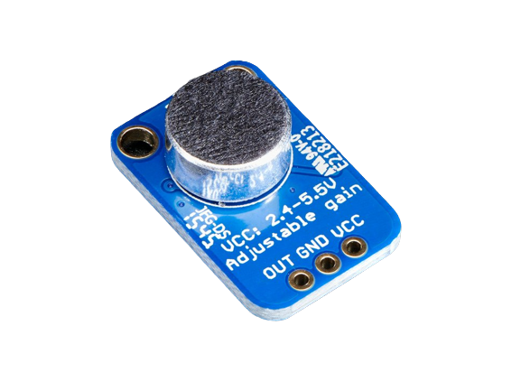

Users can not simply add a desired functionality to their device
Link Lab
Press/motion activated blink video doorbell
Blink Gateway
Amazon cloud
Closed implementation of hardware and software impedes building on existing systems
Notes:
Example: a door bell with a press switch upgrades to door bell if motion is detected
With closed source implementation we are simply limiting the potentials of existing facilities

Slide 4
What are the ways to add new features to an IoT system?
Link Lab
Software updates
Not enough without required hardware support
Get a new device from the same manufacturer
Availability
Does not benefit existing installations
Helps re-use some devices, but makes many current devices obsolete and contributes to e-waste.
Feature might not be available at all
Wait for the manufacturer to market version 2
Find a new device and completely re-build the whole network
Extremely time and cost-sensitive and maintenance-heavy
Hard to scale

Slide 5
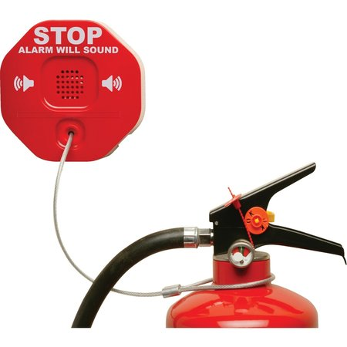

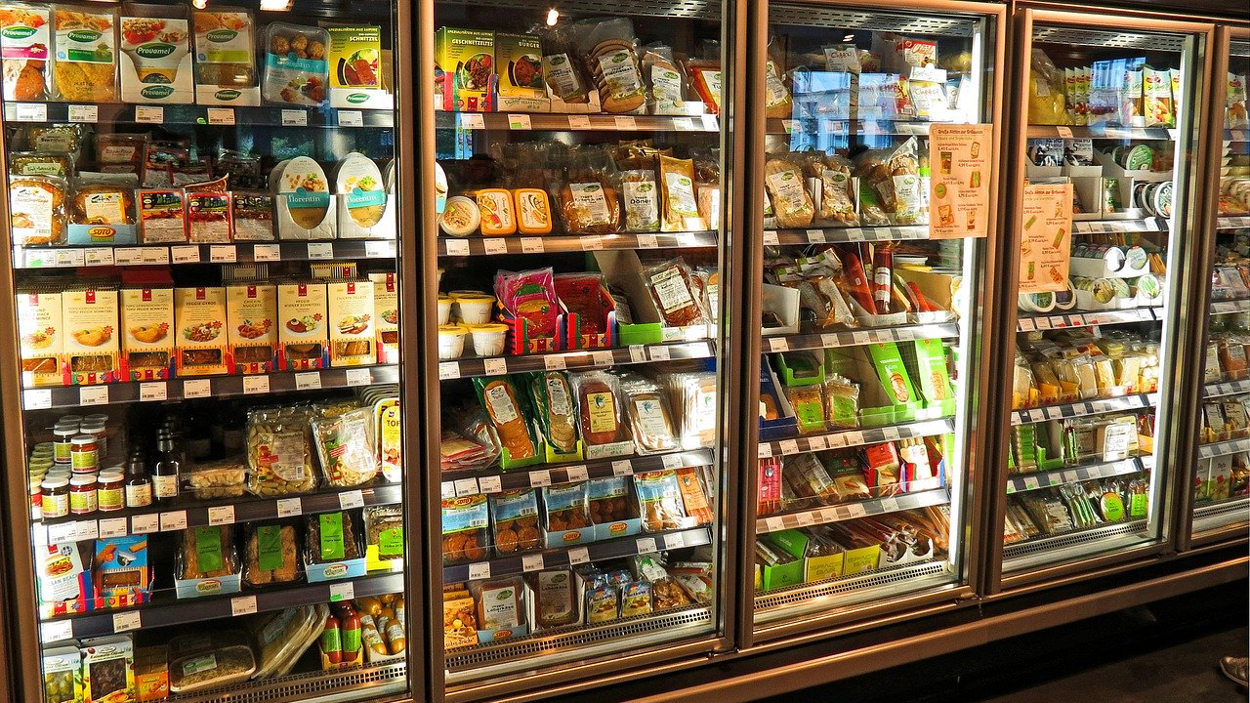
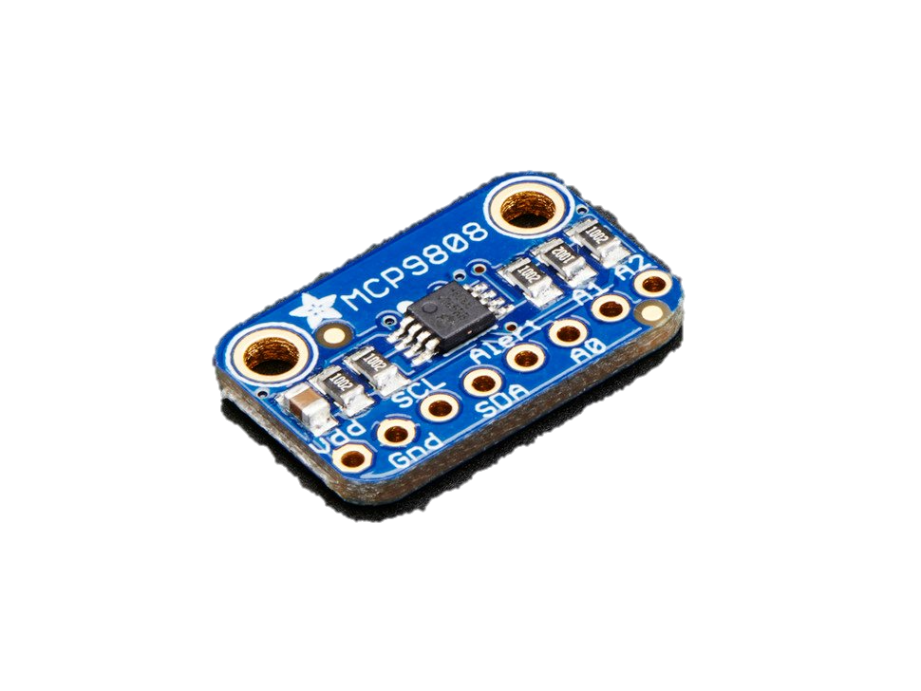
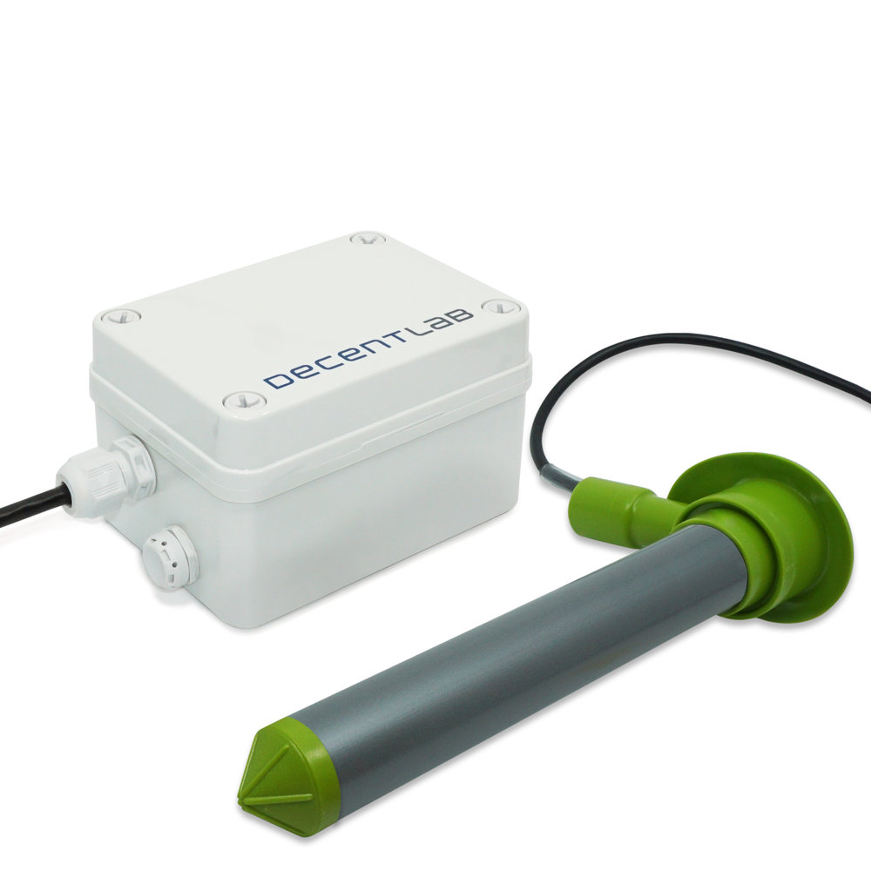
Instead .. Using existing infrastructure with minimal invasion can enable many retrofitting applications
Link Lab
{
tamper_sensor: movement_detected: 0
_storage_condition:
{ temperature: 30 ℃
}
}
{
door_sensor:
_metadata:
{
category: “cabinet”
location: “living_room”
}
}
{
freezer_sensor: temp: 0℃
_expiration:
{ “Expires in 2 days!”
}
}
Battery-powered devices can upgrade to energy-harvesting!
Users can add a new sensor with the device which the manufacturer does not provide
Important metadata can be attached
Product specific information can be advertised
Notes:
Example: a door bell with a press switch upgrades to door bell if motion is detected
4344430993 432 box2
Energy-harvesting ttile should be different for the Data packet should be updated-> not this big devices

Slide 6
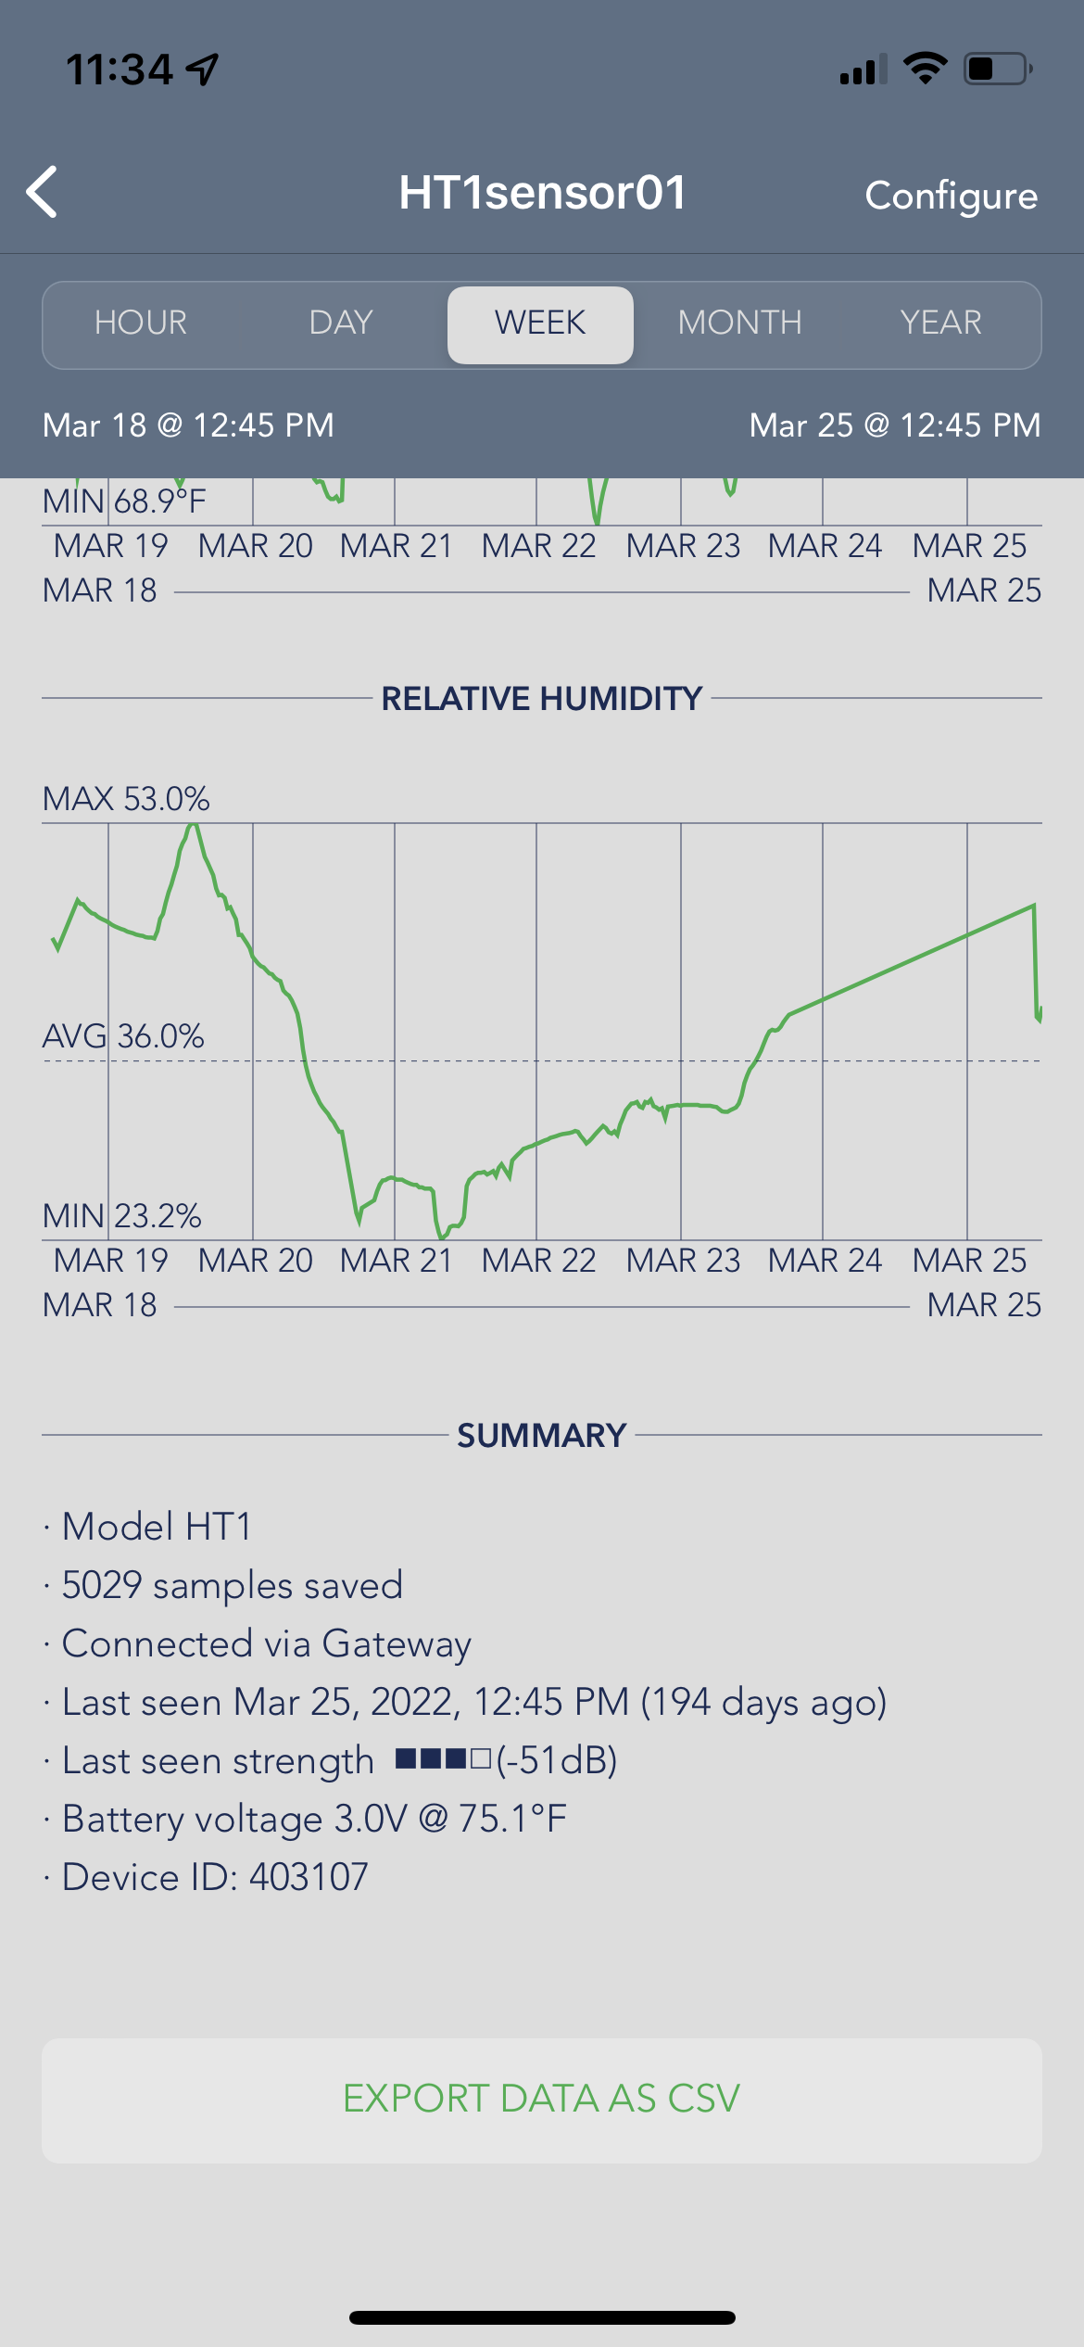
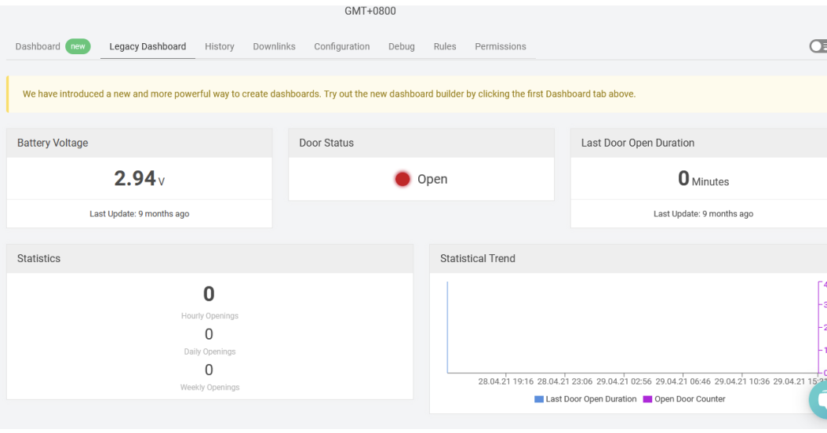
But without completely new devices, how can we upgrade an IoT system with new functionality?
Link Lab
Observation 1: Many devices report battery readings with sensor data
Notes:
Add snippets from sensor portal to show the battery voltage information The LoraWan-> not-so closed systems
BLE- closed systems. remove the 9 months

Slide 7
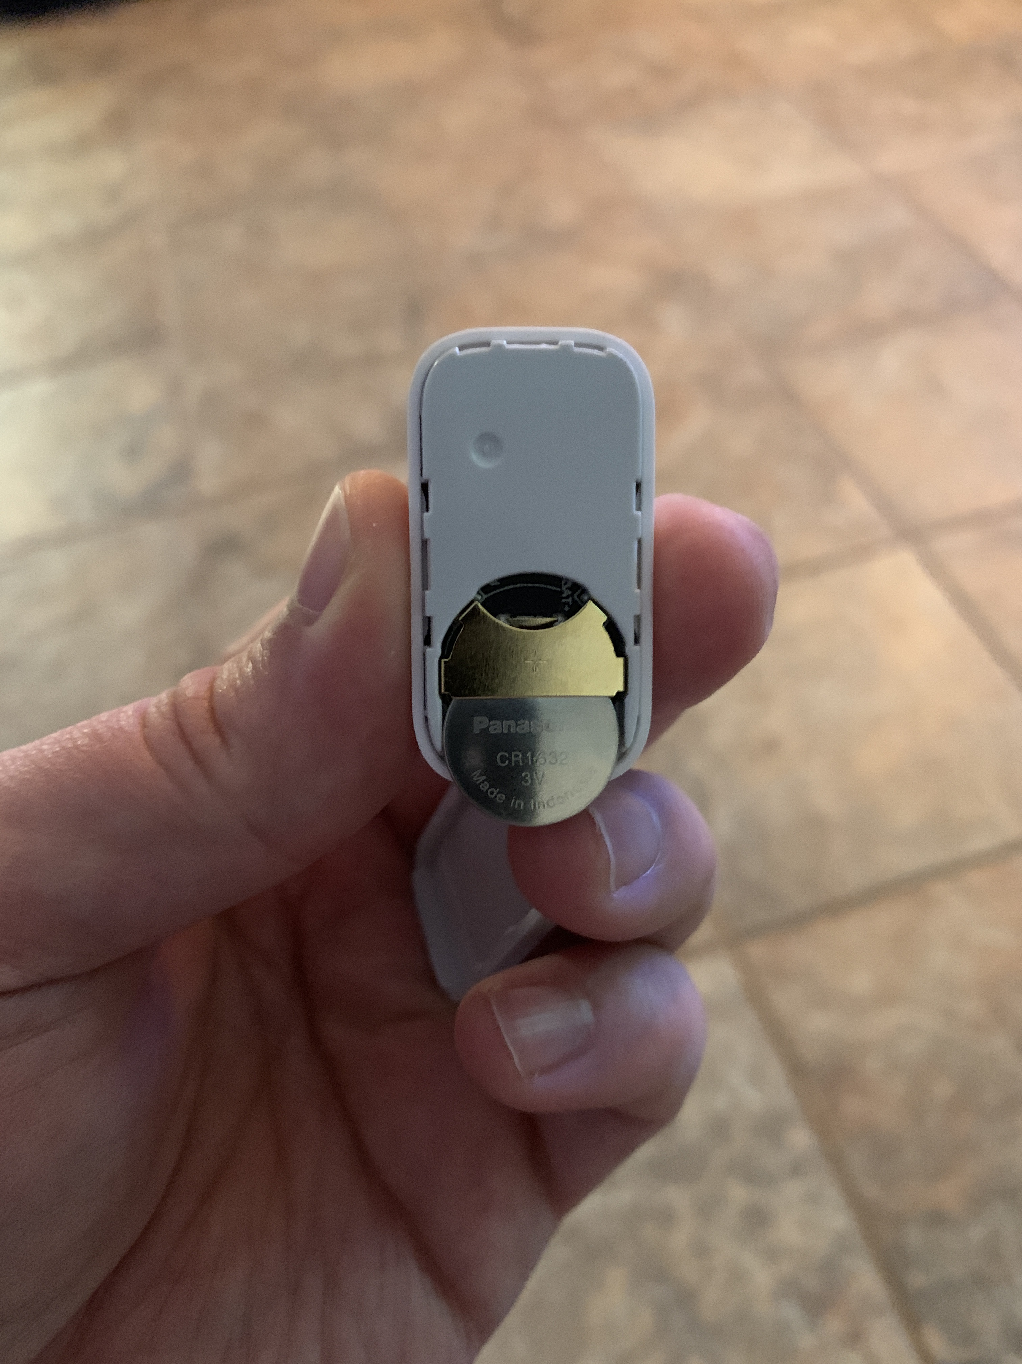
But without completely new devices, how can we upgrade an IoT device with new functionality?
Link Lab
Observation 2: Batteries are easily accessible and user-servicable
Notes:
Add snippets from sensor portal to show the battery voltage information The LoraWan-> not-so closed systems
BLE- closed systems.

Slide 8
Link Lab
We propose RetroIoT,
RetroIoT uses a device’s battery terminals to send additional data non-invasively and enables a new communication end point for IoT devices.
Notes:
In this paper, we present RetroIoT that encodes additional data into a device’s battery terminal non-vasively, making a new communication end point for an IoT device.

Slide 9
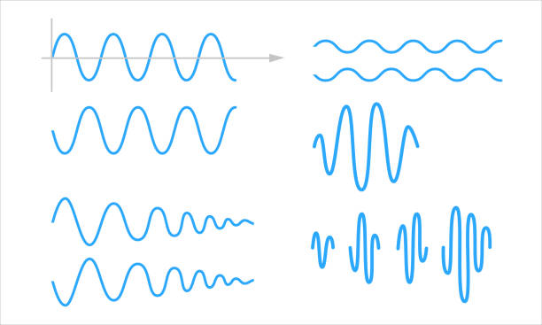

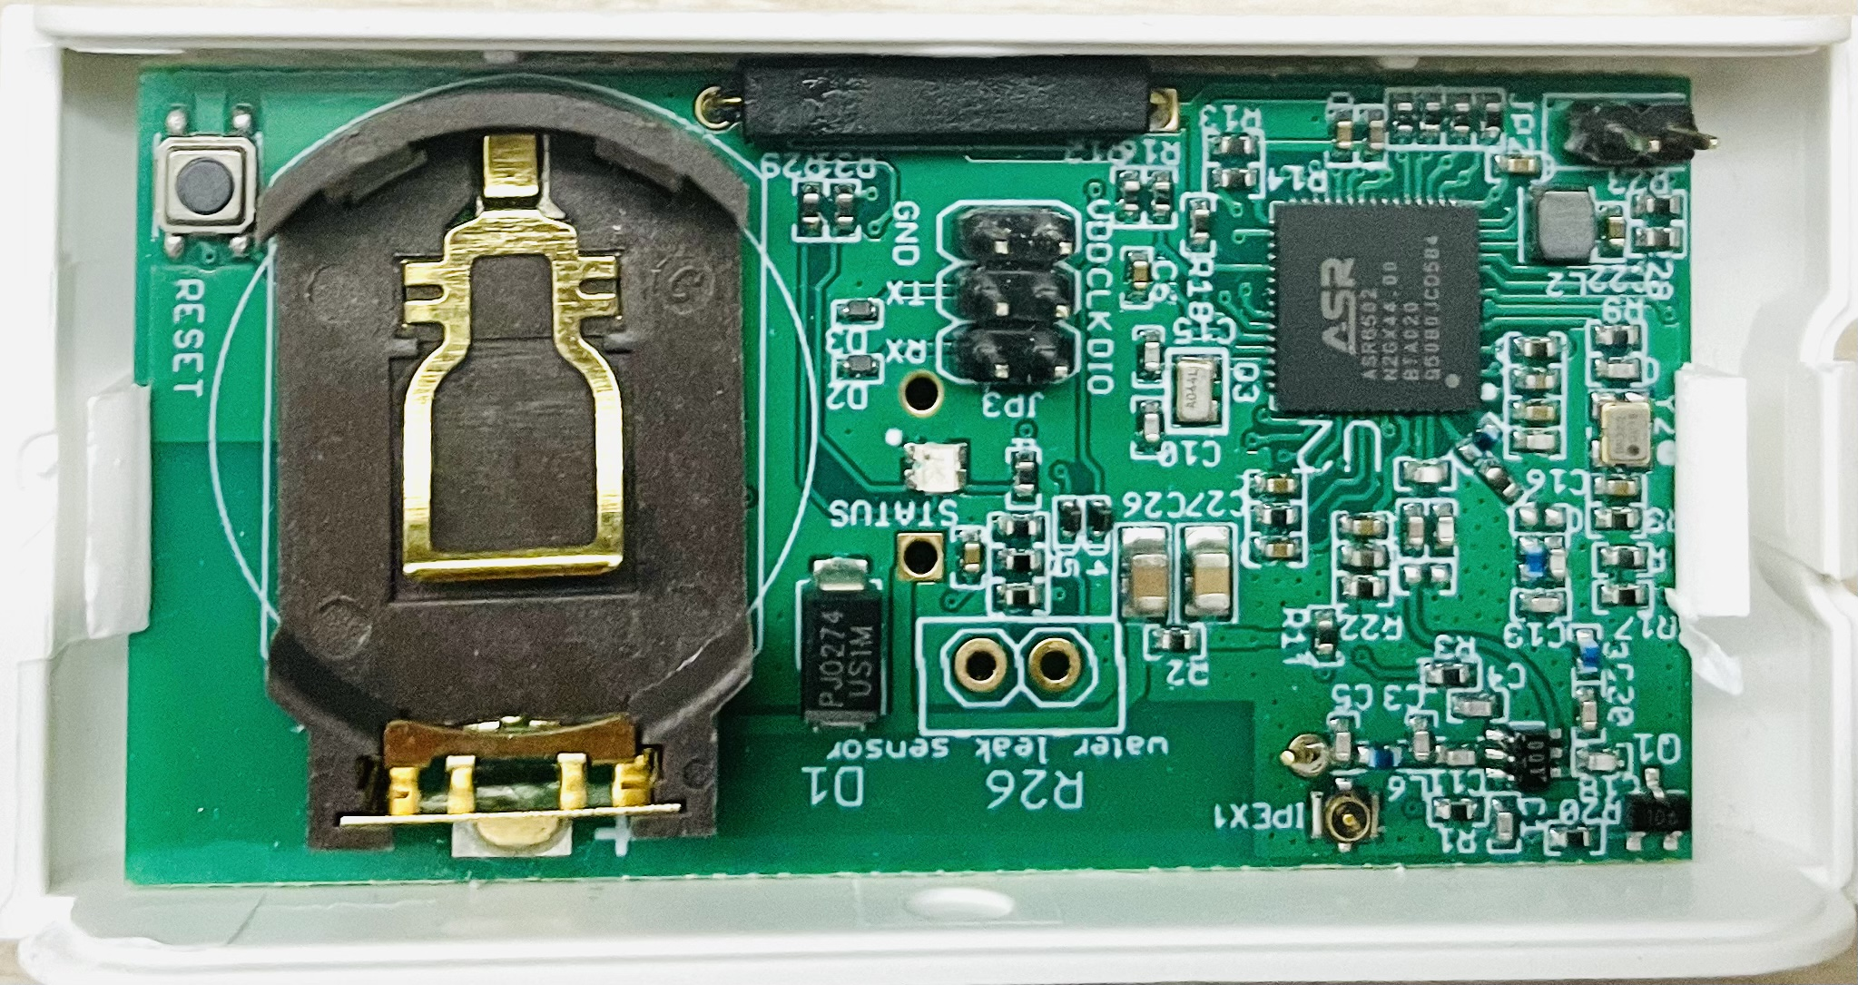
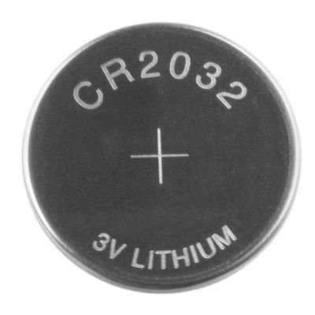


RetroIoT replaces a conventional battery with a programmable battery
Link Lab
programmable “smart” battery
Battery voltage data packets
Data extracted in cloud
Modulated battery voltage
Covert data
RetroIoT
New sensor
COTS IoT Device
Metadata tag
Notes:
RetroIoT replaces a traditional battery with a programmable battery that reads completely new data from external sensors and encode the information into the device’s battery port. The device unknowingly samples this new modulated battery voltage and transmits the battery voltage reading with its sensor data to the cloud application. The encoded data is retrieved at the cloud to infer the new sensor data. With this method, any device that samples and transmits battery voltage readings can encode additional data regardless of their communication protocols or device architecture.

Slide 10
We must fulfill several requirements to design RetroIoT
Link Lab
Can not change device hardware and software
Operating voltage and current requirements must be met
The precision of the reported battery voltage reading limits data encoding bandwidth
New data must be encoded before the device samples battery voltage
Should be able to transmit data packet over multiple readings
Notes:
RetroIoT must fulfill several design requirements to be successful:

Slide 11
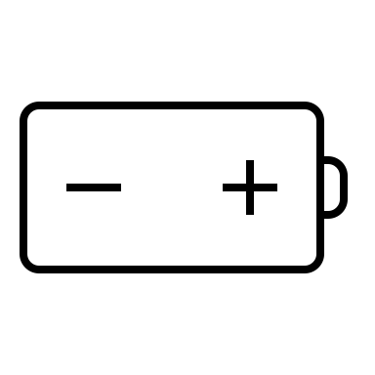
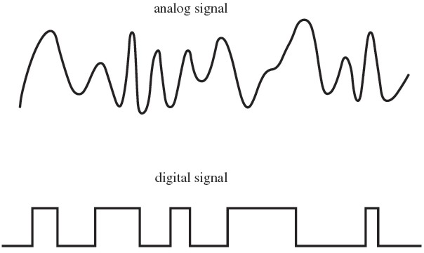
How does RetroIoT work?
Link Lab
RetroIoT analog encoder design:
Encoder Transfer Function
Analog Encoder
Analog Encoder
Battery
IoT device
Encoded voltage at the battery terminal (V)
Programmable LDO
Analog Buffer
Analog input
Analog input voltage (V)
Analog encoder receives analog voltage and converts to acceptable device operating voltage
Notes:
Add animation Draw the circuit level diagram
for the enocder-decoder digital data-> encoded to the battery don't do that

Slide 12
How does RetroIoT work?
Link Lab
RetroIoT digital encoder design:
Encoder Transfer Function
Digital Encoder
Battery
DAC Current Source
Programmable LDO
IoT device
MCU
Digital Encoder
Encoded voltage at the battery terminal (V)
Digital input
Digital Symbols
Digital encoder receives digital symbols and converts to acceptable device operating voltage

Slide 13
Digital data encoding-decoding technique
Link Lab
With 12-bit ADC and 1mV decimal precision of reported battery voltage , we can encode 128 7-bit symbols between v_{max} = 3.3V, v_{min} = 3.0V.
v_{max}
v_{n} = v_{n-1} + n*v_{rs}
v_{max} = 3.3V
v_{min} = 3.0V
Encoding at RetroIoT
v_{min}
v_{max}
Decoding at Cloud
v_{min}
Notes:
Add animation

Slide 14
How to transmit more than 7-bit data packet? Multi-symbol metadata transmitting
Link Lab
The encoder needs to know when to encode the next symbol
Digital Encoder
Detects transmission current spikes
Battery
DAC Current Source
Programmable LDO
Current monitor
IoT device
MCU
Digital input
Needs to identify the start and end of the metadata
v_{min}
v_{max}
v_{min}
v_{max}
Long metadata format
Start
Data 1
End
Data 2
Notes:
Add the BLE long metadata plot

Slide 15
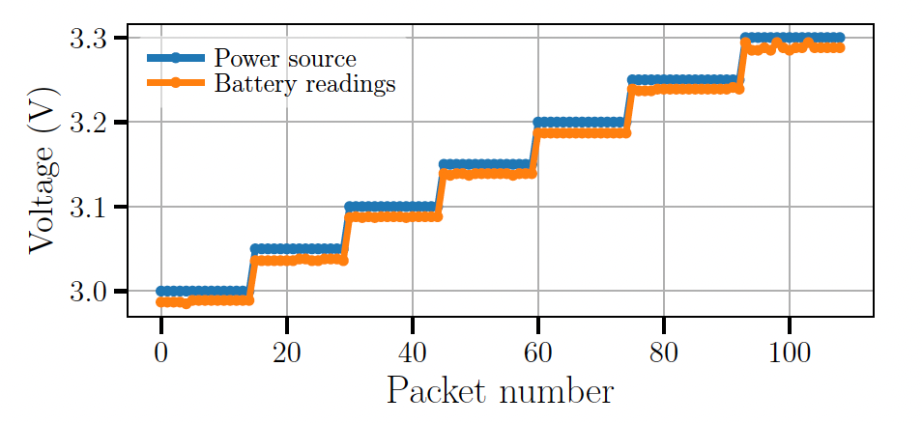
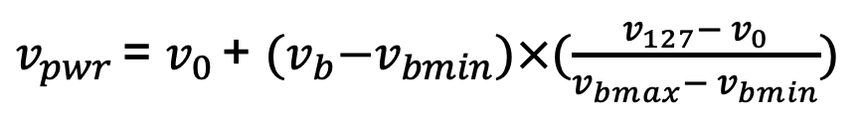
Mitigating the major source of battery voltage error
Link Lab
Linear interpolation using v_{max} and v_{min :}
$v_{pwr }$= $v_{0 }$+ ${(v}_{b}−v_{bmin})×(\frac{v_{127}− v_{0}}{v_{bmax}− v_{bmin}})$
Here, v₀ and v₁₂₇ are reserved symbol for error calibration
ADC offset error contributes to the major source of error

Slide 16
Interestingly, we can just completely replace the battery with a energy-harvesting power supply
Link Lab
But energy is limited now, how to adapt to changes in the available energy?
Energy-harvesting power supply running DPM
IoT device
Control message [sampling rate]
Decoding in Cloud
Digital Encoder
Sensor data [battery voltage]
Battery
Battery voltage [sampling rate]
Notes:
Add animation

Slide 17
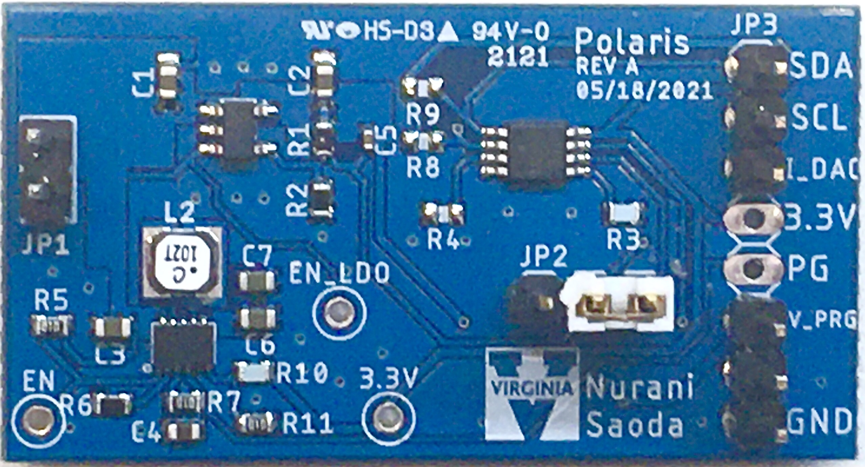
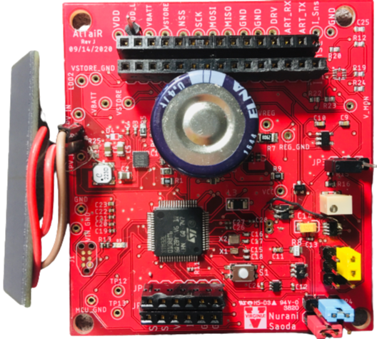
How did we implement RetroIoT?
Link Lab
Analog Encoder
Digital Encoder
Energy-harvesting power supply board
Notes:
Might be optional, not too detailed

Slide 18
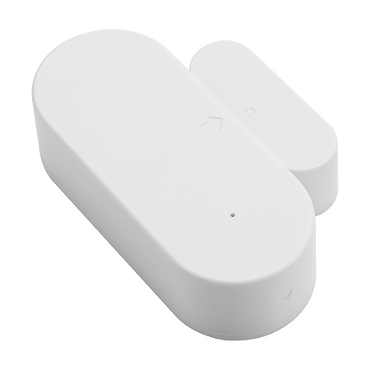


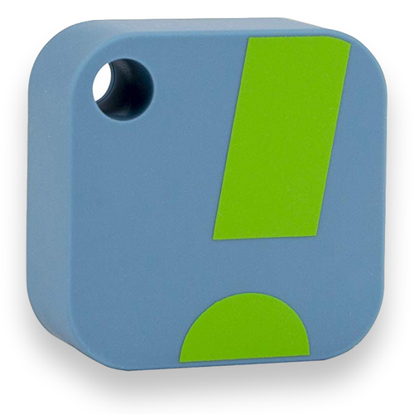
We demonstrate several retrofit applications using COTS devices
Link Lab
Soil moisture sensor
Two commercial LoRa sensing device
Gateway
Door sensor
Soil moisture sensor
LoRaWAN packet
Sensor payload
One BLE sensor temperature and humidity sensor
2 Bytes
5 Bytes
32 Bytes
Header
Soil moisture and temperature readings
Battery voltage
Example: 0x0b3b -> 2875 mV
Door sensor with location tag
Notes:
sensor emperature-> source the images->

Slide 19
What is the end-to-end battery voltage error?
Link Lab
3.96 mV
20.91 mV
Channel + Encoder Error
Channel + Encoder Error
Temperature sensing using the analog encoder
Digital symbol transmission using digital encoder
Notes:
Might be optional, not too detailed temparature error->
error can be minimized at the cost of device complexity channel? the actual voltage-> What is the channel error? explain more remove-> channel with channel+encoder CDF- interpolation Battery voltage is sacrifice-> 6

Slide 20
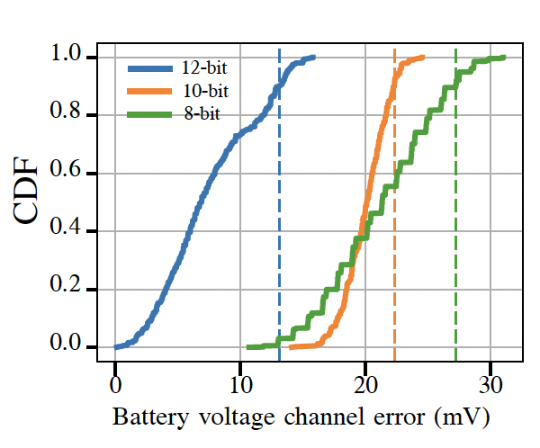
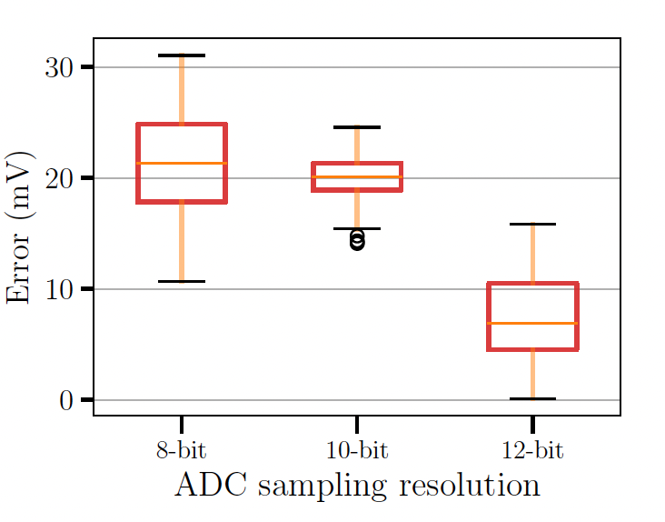
Does ADC resolution of the IoT device matter?
Link Lab
Channel + Encoder Error
2x reduction in error
Notes:
Might be optional, not too detailed

Slide 21
Demo app: upgrading a door sensor with installation-specific metadata
Link Lab
COTS Door Sensor
Battery
Metadata example
RetroIoT Digital Encoder
Format of the digital symbol
Notes:
metadata illustration
could be shown in the motivation
outline or the section-> its getting lost in the slides Do not rush add the retrofit channels at the end

Slide 22
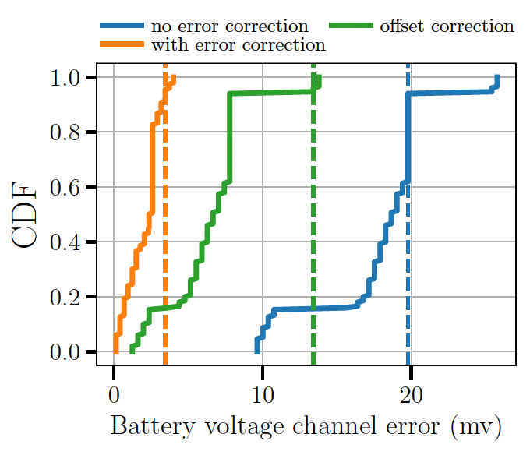
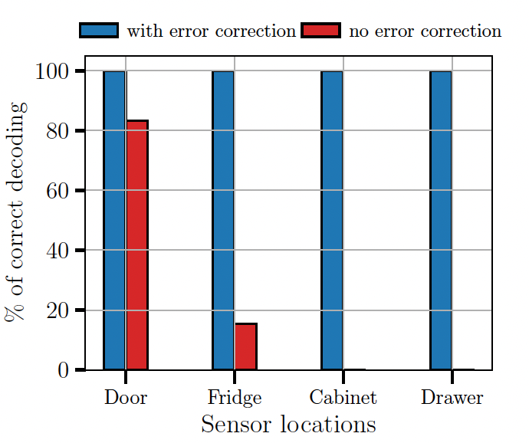
Demo App: upgrading a door sensor with installation-specific metadata
Link Lab
Successfully decoded all 12 metadata
Channel + Encoder Error
Notes:
metadata illustration
could be shown in the motivation
outline or the section-> its getting lost in the slides Do not rush add the retrofit channels at the end

Slide 23
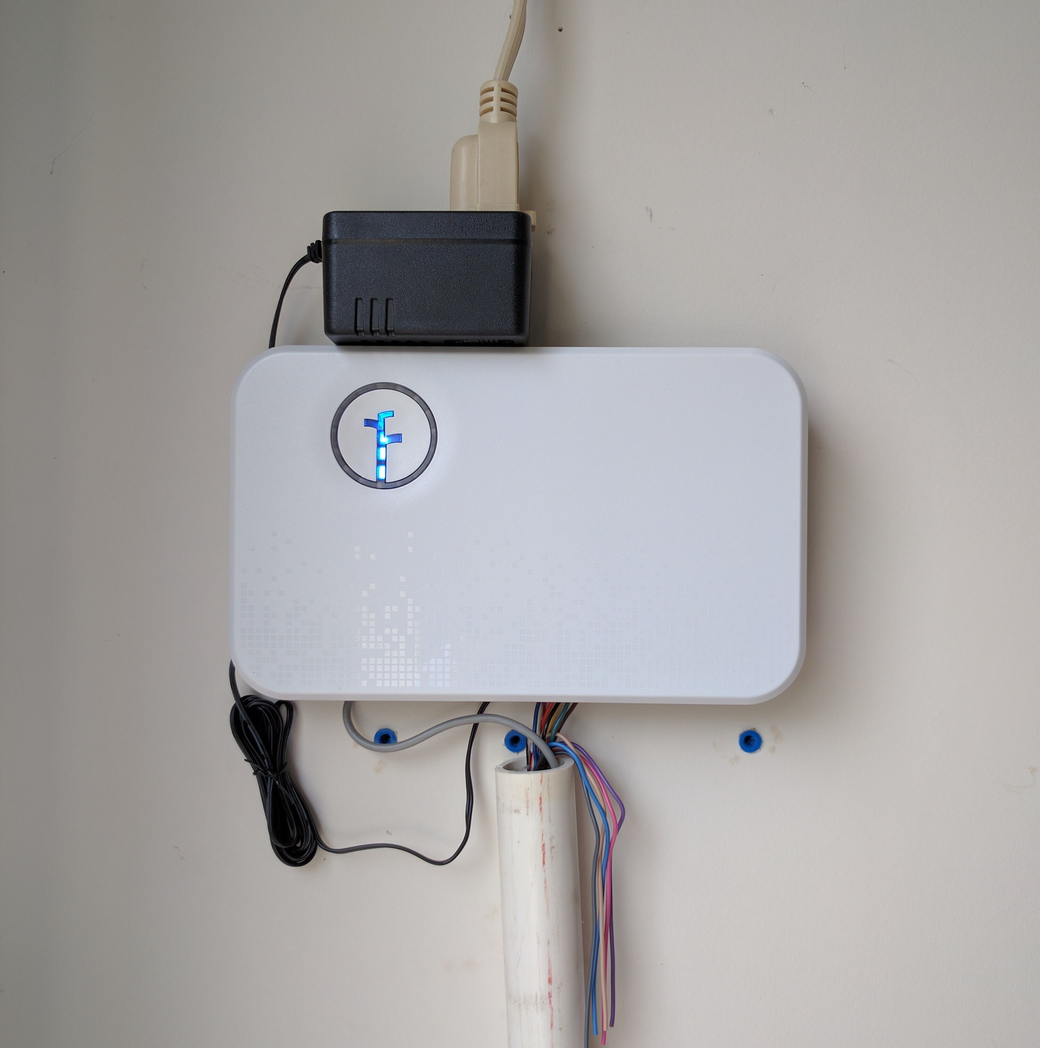
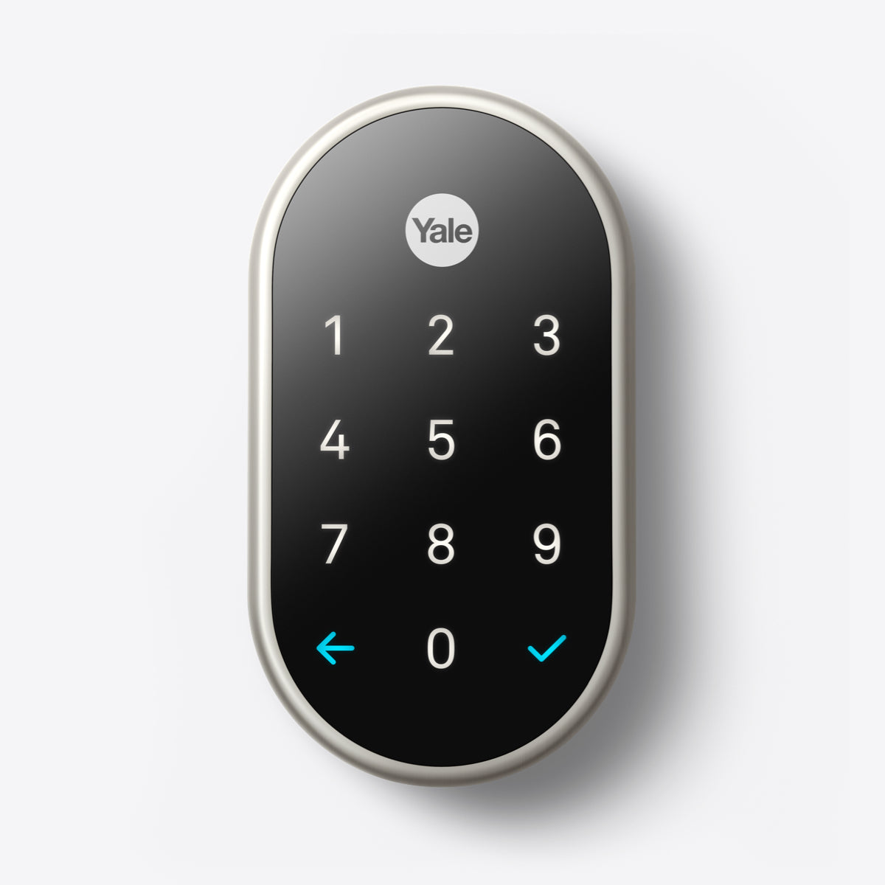
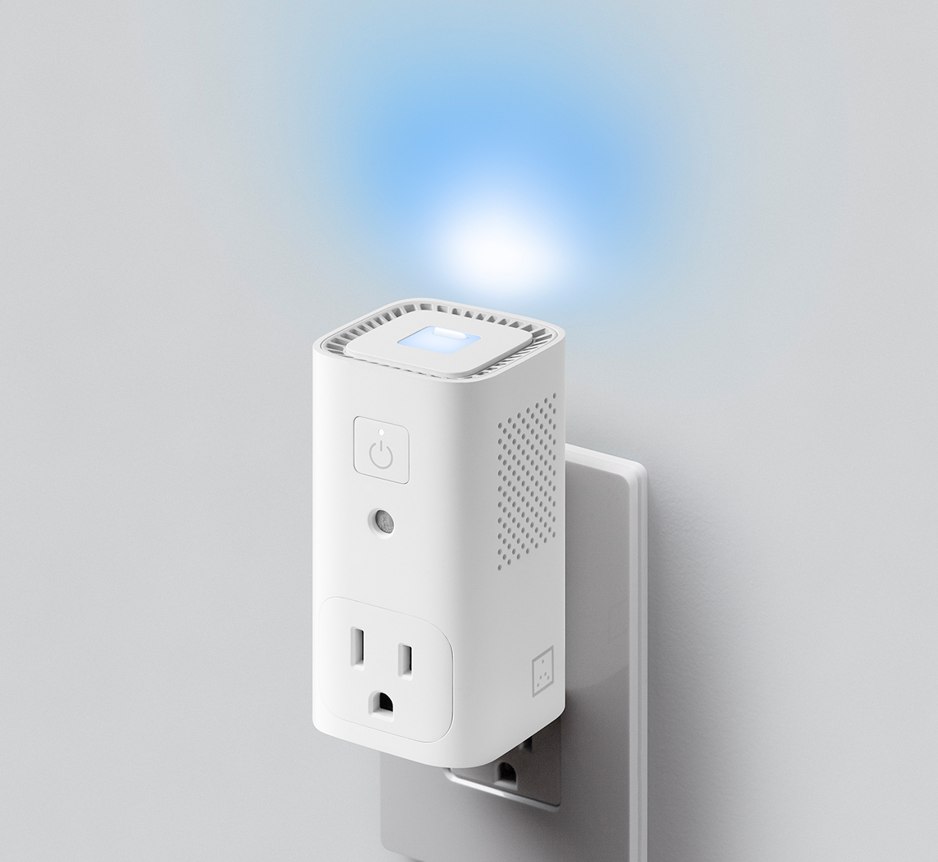
What other data open channels exist beside battery voltage?
Link Lab
Smart sprinkler controllers allow connection for external sensors like rain sensor
Smart key pads can log any arbitrary pin beyond the actual lock code
Awair Glow devices have a switchable outlet where binary data can be encoded
Notes:
metadata illustration
could be shown in the motivation
outline or the section-> its getting lost in the slides Do not rush add the retrofit channels at the end

Slide 24
Concluding remarks
RetroIoT demonstrates how existing devices can upgrade them just by replacing their battery
Demonstrates a minimally invasive technique to transmit additional data
RetroIoT will enable further research to leverage new open data channels

Slide 25
Thank you!
Link Lab
Questions?
Nurani Saoda
saoda@virginia.edu

